Slide 1
PL/SQL stands for “Procedural Language extensions to the Structured Query Language”. It is a procedural extension language for the structured query language (SQL) and the Oracle relational database.
PL/SQL allows developers to write code that is executed on the server-side, enabling them to create database applications that can manipulate data stored in Oracle databases.

Slide 2
Program Structures: Procedures and Functions
A set of SQL and PL/SQL statements grouped together as a unit (block) to solve a specific problem or perform a set of related tasks.
An anonymous block is a PL/SQL block that appears within your application and it is not named or stored in the database. In many applications, PL/SQL blocks can appear wherever SQL statements can appear.
A stored procedure is a PL/SQL block that Oracle stores in the database and can be called by name from an application. May or may not return a value.
Functions always return a single value to the caller; procedures do not return values to the caller.

Slide 3
PL/SQL Blocks
PL/SQL code is built of Blocks, with a unique structure.
Anonymous Blocks: have no name (like scripts)
can be written and executed immediately in SQLPLUS
can be used in a trigger

Slide 4
Anonymous Block Structure
DECLARE (optional)
/* Here you declare the variables you will use in this block */
BEGIN (mandatory)
/* Here you define the executable statements (what the block DOES!)*/
EXCEPTION (optional)
/* Here you define the actions that take place if an exception is thrown during the run of this block */
END; (mandatory)
/
A correct completion of a block will generate the following message:
PL/SQL procedure successfully completed
Always put a new line with only a / at the end of a block! (This tells Oracle to run the block)

Slide 5
DECLARE
Syntax
Examples
identifier [CONSTANT] datatype [NOT NULL]
[:= | DEFAULT expr];
Notice that PL/SQL includes all SQL types, and more…
Declare
birthday DATE;
age NUMBER(2) NOT NULL := 27;
name VARCHAR2(13) := 'Levi';
magic CONSTANT NUMBER := 77;
valid BOOLEAN NOT NULL := TRUE;

Slide 6
Declaring Variables with the %TYPE Attribute
Examples
Accessing column sname in table Sailors
DECLARE
sname Sailors.sname%TYPE;
fav_boat VARCHAR2(30);
my_fav_boat fav_boat%TYPE := 'Pinta';
...
Accessing another variable

Slide 7
Declaring Variables with the %ROWTYPE Attribute
Declare a variable with the type of a ROW of a table.
And how do we access the fields in reserves_record?
Accessing table Reserves
reserves_record Reserves%ROWTYPE;
reserves_record.sid:=9;
Reserves_record.bid:=877;

Slide 8
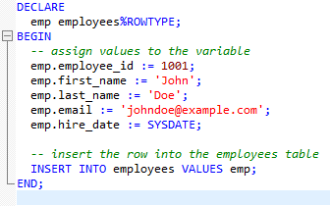
In this example, we declared a variable named "emp" with the %ROWTYPE attribute, which means it has the same data type as a row in the "employees" table. We then assigned values to the variable and inserted it into the "employees" table using the INSERT INTO statement.

Slide 9
SET SERVEROUTPUT ON is a SQLPlus command that enables the display of output generated by DBMS_OUTPUT.PUT_LINE statements in PL/SQL code. When SET SERVEROUTPUT ON is executed, the SQLPlus client's buffer for outputting data is turned on and set to a default size. This buffer is used to store output generated by DBMS_OUTPUT.PUT_LINE statements in PL/SQL code.
Without SET SERVEROUTPUT ON, any output generated by DBMS_OUTPUT.PUT_LINE statements in PL/SQL code will not be displayed in the SQL*Plus client, even if the code runs successfully. Therefore, it is essential to use SET SERVEROUTPUT ON before running PL/SQL code that uses DBMS_OUTPUT.PUT_LINE.

Slide 10
Creating a Cursor
We create a Cursor when we want to go over a result of a query (like ResultSet in JDBC)
Syntax Example:
DECLARE
cursor c is select * from sailors;
sailorData sailors%ROWTYPE;
BEGIN
open c;
fetch c into sailorData;
sailorData is a variable that can hold a ROW from the sailors table
Here the first row of sailors is inserted into sailorData

Slide 11
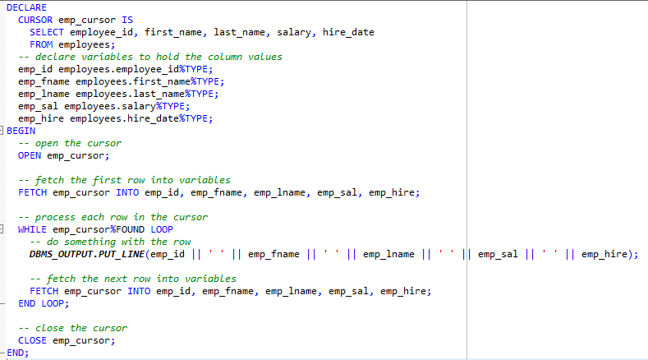

Slide 12
The A_NAME.EXTEND() method is used to dynamically increase the size of the varray A_NAME at runtime by one element. When you use A_NAME.EXTEND(), you don't need to know the size of the varray in advance, and you can add elements to the varray as needed.
On the other hand, if you declare the varray with a fixed size and initialize it with values at the beginning, you can assign values to the elements of the varray using the varray_name(index) := value syntax, as shown in the previous example. However, if you try to assign a value to an index that is beyond the fixed size of the varray, you will get a PLS-00302: component 'index' must be declared error.
So the main difference between using and not using A_NAME.EXTEND() is that with A_NAME.EXTEND(), you can dynamically resize the varray as needed, while without it, the varray has a fixed size and you cannot add more elements than the declared size.

Slide 13
SELECT Statements
DECLARE
v_sname VARCHAR2(10);
v_rating NUMBER(3);
BEGIN
SELECT sname, rating
INTO v_sname, v_rating
FROM Sailors
WHERE sid = '112';
END;
/
INTO clause is required.
Query must return exactly one row.
Otherwise, a NO_DATA_FOUND or TOO_MANY_ROWS exception is thrown

Slide 14
SQL Cursor
SQL cursor is automatically created after each SQL query. It has 4 useful attributes:
SQL%ROWCOUNT Number of rows affected by the most recent SQL statement (an integer value).
SQL%FOUND Boolean attribute that evaluates to TRUE if the most recent SQL statement affects one or more rows.
SQL%NOTFOUND Boolean attribute that evaluates to TRUE if the most recent SQL statement does not affect any rows.
SQL%ISOPEN Always evaluates to FALSE because PL/SQL closes implicit cursors immediately after they are executed.
Notes:
SQL Cursor Attributes
SQL cursor attributes allow you to evaluate what happened when the implicit cursor was last used. You use these attributes in PL/SQL statements such as functions. You cannot use them in SQL statements.
You can use the attributes, SQL%ROWCOUNT, SQL%FOUND, SQL%NOTFOUND, and SQL%ISOPEN in the exception section of a block to gather information about the execution of a data manipulation statement. PL/SQL does not consider a DML statement that affects no rows to have failed, unlike the SELECT statement, which returns an exception.

Slide 15
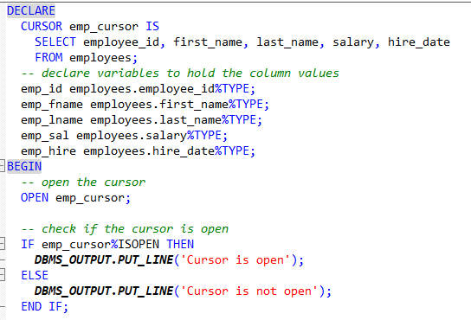
SQL%ISOPEN

Slide 16
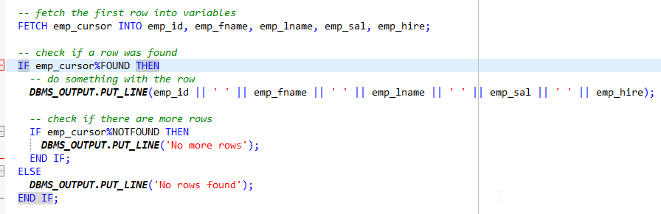
SQL%NOTFOUND

Slide 17
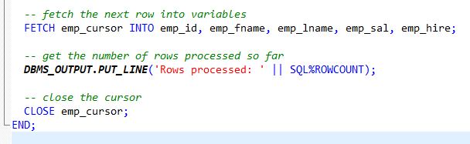
SQL%ROWCOUNT

Slide 18
Functions and Procedures

Slide 19
Functions and Procedures
It is useful to put code in a function or procedure so it can be called several times
Once we create a procedure or function in a Database, it will remain until deleted (like a table).

Slide 20
Function and Procedure Parameter Types
Named PL/SQL programs (procedures and functions) can take parameters.
Parameters are optional on both procedures and functions.
Keep the parameter name under 30 characters, they must start with a letter and contain no spaces.
There are three types of parameter: IN, OUT and
IN OUT.

Slide 21
Function and Procedure Parameter Types (cont..)
An IN parameter is used as an input only. An IN parameter cannot be changed by the called program.
An OUT parameter is initially NULL. The program assigns the parameter a value and that value is returned to the calling program.
An IN OUT parameter may or may not have an initial value. That initial value may or may not be modified by the called program. Any changes made to the parameter are returned to the calling program.

Slide 22
Function and Procedure Parameter Types(cont..)
Parameters are declared with data types but without data type length or precision.
a parameter may be declared as VARCHAR2 but it will not be declared with a length component (VARCHAR2(30) would not be valid).

Slide 23
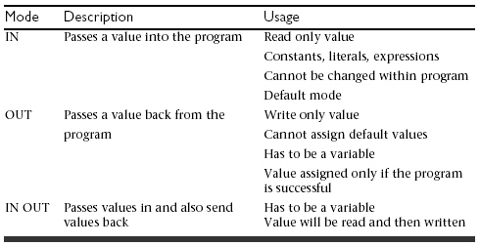
Types of Parameters

Slide 24
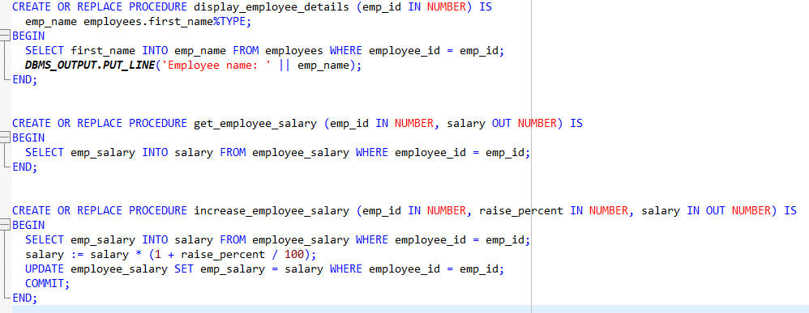

Slide 25
Creating Procedures
CREATE [OR REPLACE] PROCEDURE procedure_name
[(parameter1 [mode1] datatype1,
parameter2 [mode2] datatype2,
. . .)]
IS|AS
PL/SQL Block;
Modes:
IN: procedure must be called with a value for the parameter. Value cannot be changed
OUT: procedure must be called with a variable for the parameter. Changes to the parameter are seen by the user (i.e., call by reference)
IN OUT: value can be sent, and changes to the parameter are seen by the user
Default Mode is: IN

Slide 26
Example 13.4 – Procedure with No Parameters
CREATE OR REPLACE PROCEDURE DisplaySalary IS
temp_Salary NUMBER(10,2);
BEGIN
SELECT Salary INTO temp_Salary FROM Employee
WHERE EmployeeID = '01885';
IF temp_Salary > 15000 THEN
DBMS_OUTPUT.PUT_LINE ('Salary > 15,000.');
ELSE
DBMS_OUTPUT.PUT_LINE ('Salary < 15,000.');
END IF;
EXCEPTION
WHEN NO_DATA_FOUND THEN
DBMS_OUTPUT.PUT_LINE ('Employee not found.');
END DisplaySalary;
/

Slide 27
Example 13.5 – Passing IN and OUT Parameters
CREATE OR REPLACE PROCEDURE DisplaySalary2(p_EmployeeID
IN CHAR, p_Salary OUT NUMBER) IS
v_Salary NUMBER(10,2);
BEGIN
SELECT Salary INTO v_Salary FROM Employee
WHERE EmployeeID = p_EmployeeID;
IF v_Salary > 15000 THEN
DBMS_OUTPUT.PUT_LINE ('Salary > 15,000.');
ELSE
DBMS_OUTPUT.PUT_LINE ('Salary <= 15,000.');
END IF;
p_Salary := v_Salary;
EXCEPTION
WHEN NO_DATA_FOUND THEN
DBMS_OUTPUT.PUT_LINE ('Employee not found.');
END DisplaySalary2;

Slide 28
Example 13.6 – Calling DisplaySalary2
DECLARE
v_SalaryOutput NUMBER := 0;
BEGIN
DisplaySalary2('01885', v_SalaryOutput);
DBMS_OUTPUT.PUT_LINE ('Actual salary: '
||TO_CHAR(v_SalaryOutput));
END;
/
Salary > 15,000.
Actual salary: 16250
PL/SQL procedure successfully completed.

Slide 29
Procedures
Creation command
Variable declarations
Body of code
Create or replace procedure sample1 as
v_num1 constant number := 2.5;
v_num2 constant number := 4;
v_product number;
BEGIN
v_product := v_num1 * v_num2;
END;
Notes:
This is a very simple procedure and one which would not be used in the real world but it should illustrate to you the syntax of a procedure creation. There are a number of unofficial conventions which are apparent here but will be expanded upon now. The first is the naming conventions. Variables on the example are named with the v_ prefix, this is therefore apparent to those reading the code that these are variables and not field names, this becomes more useful the more complex the code. In the same way a cursor will be prefixed with cur_ so that it is obvious when the code is read that a cursor is being accessed etc.

Slide 30
Example- what does this do?
Table mylog
create or replace procedure
num_logged
(person IN mylog.who%TYPE,
num OUT mylog.logon_num%TYPE)
IS
BEGIN
select logon_num
into num
from mylog
where who = person;
END;
/
logon_ num | who
3 | Pete
4 | John
2 | Joe
Inside the procedure body, a SELECT statement is used to retrieve the value of the "logon_num" column from the "mylog" table, where the "who" column matches the "person" parameter.
Notes:
Output the number of logons to variable num given the name of person from person

Slide 31
Calling the Procedure
declare
howmany mylog.logon_num%TYPE;
begin
num_logged(‘John',howmany);
dbms_output.put_line(howmany);
end;
/
More procedures: p3.sql

Slide 32
Errors in a Procedure
When creating the procedure, if there are errors in its definition, they will not be shown
To see the errors of a procedure called myProcedure, type
SHOW ERRORS PROCEDURE myProcedure
in the SQLPLUS prompt
For functions, type
SHOW ERRORS FUNCTION myFunction

Slide 33
Dropping a Procedure
The SQL statement to drop a procedure is the straight-forward DROP PROCEDURE <procedureName> command.
This is a data definition language (DDL) command, and so an implicit commit executes prior to and immediately after the command.
SQL> DROP PROCEDURE DisplaySalary2;
Procedure dropped.

Slide 34
FUNCTIONS
Functions are a type of stored code and are very similar to procedures.
The significant difference is that a function is a PL/SQL block that returns a single value.
Functions can accept one, many, or no parameters, but a function must have a return clause in the executable section of the function.
The datatype of the return value must be declared in the header of the function.
A function is not a stand-alone executable in the way that a procedure is: It must be used in some context. You can think of it as a sentence fragment.
A function has output that needs to be assigned to a variable, or it can be used in a SELECT statement.

Slide 35
Creating a Function
Almost exactly like creating a procedure, but you supply a return type
CREATE [OR REPLACE] FUNCTION
function_name
[(parameter1 [mode1] datatype1,
parameter2 [mode2] datatype2,
. . .)]
RETURN datatype
IS|AS
PL/SQL Block;

Slide 36
A Function
create or replace function
rating_message(rating IN NUMBER)
return VARCHAR2
AS
BEGIN
IF rating > 7 THEN
return 'You are great';
ELSIF rating >= 5 THEN
return 'Not bad';
ELSE
return 'Pretty bad';
END IF;
END;
/
NOTE THAT YOU DON'T SPECIFY THE SIZE

Slide 37
Calling the function
declare
paulRate:=9;
Begin dbms_output.put_line(ratingMessage(paulRate));
end;
/
More functions: p4.sql

Slide 38
Creating a function:
create or replace function squareFunc(num in number)
return number
is
BEGIN
return num*num;
End;
/
Using the function:
BEGIN
dbms_output.put_line(squareFunc(3.5));
END;
/

Slide 39
Stored Procedures and Functions
The procedures and functions we discussed were called from within the executable section of the anonymous block.
It is possible to store the procedure or function definition in the database and have it invoked from various of environments.
This feature allows for sharing of PL/SQL code by different applications running in different places.

Slide 40
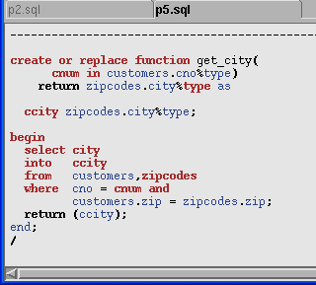
Stored function: p5.sql
Call Stored function
SQL>SELECT CNO, CNAME, get_city(cno)
2 from customers;
CNO CNAME GET_CITY(CNO)
------ --------- --------------------
1111 Charles Wichita
2222 Bertram Wichita
get_city function returns city name given customer number.
customers(cno, cname, zip) zipcodes(cnum, zip, city)

Slide 41
Benefits of Stored Procedures I
Security
Control data access through procedures and functions.
E.g. grant users access to a procedure that updates a table, but not grant them access to the table itself.
Performance
The information is sent only once between database and application and thereafter invoked when it is used.
Network traffic is reduced compared with issuing individual SQL statements or sending the text of an entire PL/SQL block
A procedure's compiled form is readily available in the database, so no compilation is required at execution time.
The procedure might be cached

Slide 42
Benefits of Procedures II
Memory Allocation
Stored procedures take advantage of the shared memory capabilities of Oracle
Only a single copy of the procedure needs to be loaded into memory for execution by multiple users.
Productivity
By designing applications around a common set of procedures, you can avoid redundant coding and increase your productivity.
Procedures can be written to insert, update, or delete rows from a table and then called by any application without rewriting the SQL statements necessary to accomplish these tasks.
If the methods of data management change, only the procedures need to be modified, not all of the applications that use the procedures.

Slide 43
Benefits of Procedures III
Integrity
Stored procedures improve the integrity and consistency of your applications. By developing all of your applications around a common group of procedures, you can reduce the likelihood of committing coding errors.
You can test a procedure or function to guarantee that it returns an accurate result and, once it is verified, reuse it in any number of applications without testing it again.
If the data structures referenced by the procedure are altered in any way, only the procedure needs to be recompiled; applications that call the procedure do not necessarily require any modifications.

Slide 44
Procedures VS Functions
Procedures are traditionally the workhorse of the coding world
functions are traditionally the smaller, more specific pieces of code.
In general, if you need to update the chart of accounts, you would write a procedure.
If you need to retrieve the organization code for a particular GL account, you would write a function.

Slide 45
Procedures VS Functions(cont..)
Here are a few more differences between a procedure and a function:
A function MUST return a value
A procedure cannot return a value
Procedures and functions can both return data in OUT and IN OUT parameters
The return statement in a function returns control to the calling program and returns the results of the function

Slide 46
Procedures VS Functions (cont..)
The return statement of a procedure returns control to the calling program and cannot return a value
Functions can be called from SQL, procedure cannot
Functions are considered expressions, procedure are not
That's about all the differences I can think of off the top of my head. Can you think of any more?

Slide 47
Trigger
In SQL, a trigger is a special type of stored procedure that is automatically executed in response to certain database events, such as INSERT, UPDATE or DELETE operations on a particular table. The purpose of a trigger is to perform a specific action or set of actions based on the occurrence of the triggering event.

Slide 48
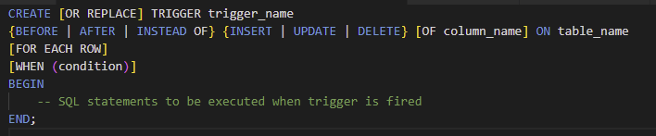
Trigger

Slide 49
CREATE [OR REPLACE] TRIGGER: This creates a new trigger with the specified name, or replaces an existing trigger with the same name if the OR REPLACE clause is used.
trigger_name: The name of the trigger.
{BEFORE | AFTER | INSTEAD OF}: This specifies when the trigger should be executed, either before the triggering event (BEFORE), after the triggering event (AFTER), or instead of the triggering event (INSTEAD OF).
{INSERT | UPDATE | DELETE}: This specifies the type of event that should trigger the execution of the trigger.
[OF column_name]: This is an optional clause that specifies which column or columns in the table should trigger the execution of the trigger.
ON table_name: This specifies the name of the table on which the trigger should be created.
[FOR EACH ROW]: This specifies that the trigger should be executed once for each row affected by the triggering event. This clause is required for AFTER and INSTEAD OF triggers, but optional for BEFORE triggers.
[WHEN (condition)]: This is an optional clause that specifies a condition that must be satisfied for the trigger to be executed.
BEGIN and END: These are the start and end points of the trigger code block, where you can write SQL statements to be executed when the trigger is fired.

Slide 50
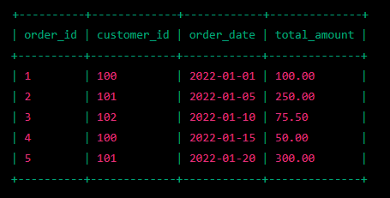
Suppose we have a table named orders with columns order_id, customer_id, order_date, and total_amount. We want to keep track of the total revenue generated by each customer in a separate table named customer_revenue. To achieve this, we can create a trigger on the orders table that updates the customer_revenue table whenever a new order is inserted or an existing order is updated.

Slide 51
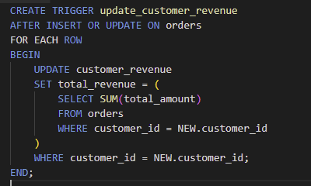

Slide 52
This trigger is called update_customer_revenue and is executed AFTER an INSERT or UPDATE operation on the orders table. The FOR EACH ROW clause specifies that the trigger should be executed once for each row affected by the triggering event.
The trigger contains a BEGIN and END block that contains the SQL statements to be executed when the trigger is fired. In this case, the trigger updates the total_revenue column in the customer_revenue table using a subquery that calculates the sum of the total_amount column for all orders placed by the customer specified in the NEW row. The NEW keyword refers to the row that caused the trigger to be fired.
Once this trigger is created, any new orders or updates to existing orders in the orders table will automatically trigger the update_customer_revenue trigger, which will update the corresponding customer's revenue in the customer_revenue table.

